Slide 1
Portfolio
Submitted To Submitted By
Khan Md.Hasib Mobassira Atika
Lecturer,Department of CSE ID:UG02-41-16-010
State University Of Bangladesh

Slide 2
OUTLINES
Introduction
Development – Tools
Goals
Conclusion

Slide 3
Introduction
A personal portfolio is an evidentiary document designed to provide qualitative and quantitative information

Slide 4
Portfolio Objectives
Portfolios provide documented evidence of effectiveness from a variety of sources—not just student ratings—and provide context for that evidence.
The process of selecting and organizing material for a portfolio can help one reflect on and improve one’s teaching and service.

Slide 5
Portfolio Components
Your Thoughts about Teaching and Service to Students_____
A reflective statement describing your personal philosophy, strategies, and objectives.
A personal statement describing your professional goals for the next few years and how those goals will be achieved

Slide 6
Development Tools
Language: HTML, Bootstrap for CSS.
Software: Sublime Text.
Browser: Chrome.

Slide 7
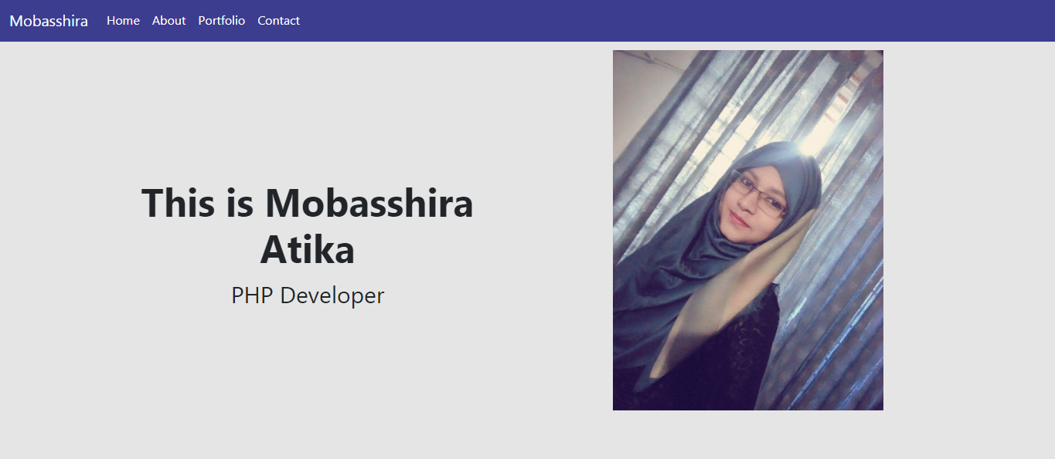
This is my Home page

Slide 8
Conclusion
In this project I am able to make my portfolio website design using HTML and Bootstrap for CSS.

Slide 9


